Slide 1


Green Pace
Security Policy Presentation
Developer: Tatiana Case
Notes:
Hello everyone and welcome to the Security Policy Presentation for Green Pace. Developed by myself, Tatiana Case

Slide 2

OVERVIEW: DEFENSE IN DEPTH
Notes:
This defense overview highlights a layered security strategy to prevent threats. We begin with a strong perimeter defense to filter incoming threats. The diagram shows critical layers of protection, including user authentication, endpoint security, and data encryption. Application security will continuously monitor our defenses. In case of an incident, our response plan ensures prompt action and quick recovery. This multifaceted approach will increase our resilience to cyber threats.

Slide 3
THREATS MATRIX
Likely STD-001-CPP STD-002-CPP STD-003-CPP | Priority STD-002-CPP STD-003-CPP STD-008-CPP STD-009-CPP
Low priority STD-006-CPP STD-007-CPP | Unlikely STD-005-CPP STD-006-CPP
Notes:
The threat matrix below summarizes key security risks. The table categorizes internal and external threats based on likelihood and priority. Each cell will detail the threat risk, which will be discussed further in the presentation. Automated tools can identify vulnerabilities by scanning code and highlighting issues such as SQL injection, buffer overflow, and other security flaws. Integrating automation into the development pipeline allows for proactive problem detection and resolution, leading to cost savings in the long run.

Slide 4
10 PRINCIPLES
Validate Input Data
Heed Compiler Warnings
Architect and Design for Security Policies
Keep it simple
Default Deny
Adhere to the Principle of Least Privilege
Sanitize Data Sent to Other Systems
Practice Defense in Depth
Use Effective Quality Assurance Techniques
Notes:
This slide outlines ten core development principles that align with coding standards for a secure and cohesive approach. The "Validate Input Data" principle aligns with the "Preventing SQL Injection" coding standard, as SQL injection poses a risk of data vulnerabilities. Input sanitization and validation help prevent malicious or incorrect data. Implementing these principles and coding standards ensures compliance and security across all projects, not just one application.

Slide 5
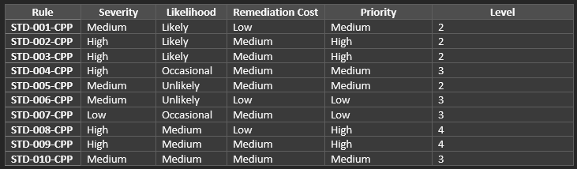
CODING STANDARDS
Notes:
This slide presents an overview of coding standards. Efficient management involves assessing the severity, likelihood of exploitation, and remediation costs. Prioritize implementing likely threats to ensure effective remediation efforts. The standards are organized by priority level, enabling us to prioritize resources that require immediate attention while maintaining a systematic approach. This strategy provides a proactive and streamlined response to potential vulnerabilities.

Slide 6
ENCRYPTION POLICIES
Encryption at Rest:
Safeguarding data while it's kept in file systems, databases, or other storage devices is known as encryption at rest. This policy covers all private and sensitive information kept on the systems of the company.
Encryption in Flight:
Encryption in flight provides data security during network transmission. In order to safeguard data during transmission from interception and unauthorized access, this policy is crucial.
Encryption in Use:
When encryption is used, data is safeguarded during processing or application use. In order to protect sensitive data while it is being processed actively, this policy is essential.
Notes:
This slide depicts our encryption strategies for data at rest, in flight, and during use.
Encryption at rest ensures data security and confidentiality, even during extended storage periods. At-flight encryption aims to secure data during transmission and prevent unauthorized access or use by third parties. Encryption protects data during processing and ensures confidentiality throughout its lifecycle. Implementing these strategies creates a layered defense, providing a resilient and comprehensive shield to secure data across pipeline stages.

Slide 7
TRIPLE-A POLICIES
Authentication:
Verifying the identity of users and systems gaining access to the organization's resources is the process of authentication. This policy makes sure that sensitive information can only be accessed by authorized parties.
Authorization:
The degree of access that authenticated users are granted is determined by authorization. Users can only access the resources required for their roles, thanks to this policy.
Accounting:
Accounting entails keeping tabs on user activity within the systems used by the company. This policy is essential for keeping track of user actions in an audit trail.
Notes:
Welcome to the triple-A slide, which covers the fundamental principles of authentication, authorization, and accounting. Authentication serves as a gateway, verifying user and system identities and enforcing access controls to prevent unauthorized entry. Authorization uses a role-based permission system to specify access levels and adhere to the principle of least privilege. The accounting section will monitor user and system activities to ensure accountability, early detection, and compliance with regulations. These frameworks create a secure network to protect against unauthorized access, improving security and response capabilities.

Slide 8
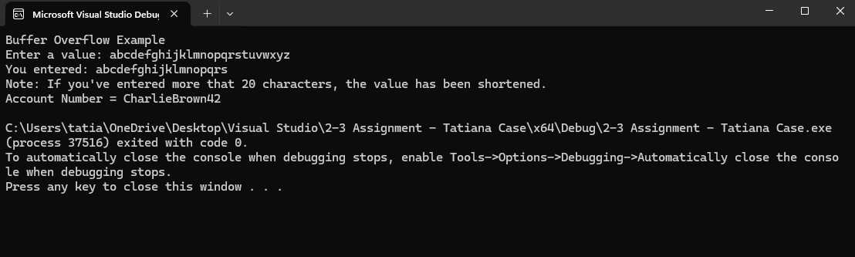
Unit Testing
Unit test practices come early and often throughout the development process to ensure the code is functioning and secure. For example, adding limitations to the number of characters a user can input
Notes:
A unit test that adds character input limitations to user inputs is an important safeguard for program integrity and security. By defining and enforcing constraints on the character types and ranges that can be entered, these tests ensure that only valid and expected inputs are processed. This prevents a number of issues, including input validation errors, data corruption, and unexpected behavior. More importantly, it serves as a first line of defense against security flaws like SQL injection and cross-site scripting (XSS) by blocking potentially malicious characters. Comprehensive unit tests simulate a variety of input scenarios, including edge cases and invalid data, to ensure that the input limitations are strong and effective. Consequently, these tests improve the overall reliability, security, and stability of the program.

Slide 9

AUTOMATION SUMMARY
Notes:
During the assess and plan phase, security automation involves integrating code analysis tools directly into the IDE to detect and eliminate vulnerabilities.
During the design and build phase, dynamic analysis tools will be used to identify and fix runtime errors or bugs. The verification and testing phase will include security checks to prevent the advancement of insecure code, resulting in a more secure program. Following this, the transition and health check phase will include automated security testing to ensure the deployed code meets security standards. During the monitor and detect phase, self-protection tools will continuously scan the application to detect security threats early on. During the response phase, our automated response mechanism will address security incidents quickly and effectively. In the final phase, continuous security checks and automated testing will ensure the system's stability and security.

Slide 10
TOOLS
DevSecOps integrates security across the software development lifecycle. DevSecOps processes include planning, coding, building, testing, deployment, and monitoring. Useful tools include Jira, CppCheck, SonarQube, Jenkins, and Fortify. External tools like Terraform, Vault, and Splunk can improve infrastructure, container, and log security. This approach aims to automate processes, reduce vulnerabilities, and ensure industry compliance.
Notes:
Our tools slide demonstrates a streamlined DevSecOps approach that integrates various software development lifecycle tools.
Tools like Jora, CppCheck, SonarQube, Jenkins, Fortify, Terraform, Vault, and Splunk help automate processes, reduce vulnerabilities, and ensure industry compliance. Jira assists with planning, while Jenkins ensures proper building and testing. CppCheck and SonarQube are useful tools for analyzing dynamic code. Fortify strengthens defense against potential vulnerabilities, while Terraform, Vault, and Splunk provide additional layers of infrastructure, management, and log security. Using these tools in our toolbox can significantly reduce vulnerabilities and attacks, leading to increased security and streamlined development processes.

Slide 11
RISKS AND BENEFITS
Risks of waiting:
Time consuming and pricey repairs
Liability
Loss of trust and reputation
Benefits of early action:
Preventing possibly breaches
Having the time to add defense in layers
Reduces Liability
Increases trust and reputation
Eliminates risks before a possible hacker does
Notes:
This risk management slide discusses the risks of waiting and the advantages of acting quickly. Waiting can lead to costly and time-consuming updates, compromised sensitive information, and negative impact on the company's reputation and public image. However, taking early action has numerous benefits. Early intervention can prevent damage, reduce risk, lower liability, and improve reputation. Acting early allows us to identify and resolve potential issues before they negatively impact the program.

Slide 12
RECOMMENDATIONS
Automated Security Testing:
Enhance the development pipeline with comprehensive tools. For Example, Veracode
Detect vulnerabilities early which will reduce the chances of security breaches.
Incident Response Plan Refinement:
Learn for incidents that have already occurred.
Refine response plan for increased effectiveness in response strategies.
Notes:
This slide provides additional recommendations for improving security. Using Veracode during the development pipeline reduces the risk of security breaches by detecting vulnerabilities early. This proactive approach will ensure our codebase adheres to secure coding standards, providing a strong defense against threats. To improve our incident response plan, we can learn from real-world examples, such as the Ashley Madison data breach. By leveraging our experiences, we can enhance the effectiveness of our incident response plan and be prepared for potential issues. These measures will strengthen our security strategy and protect users and their data.

Slide 13
CONCLUSIONS
ISO/IEC 27001 Adoption:
Systemic approach fort managing sensitive information
Ensures data integrity and reliability
Zero Trust Security Model:
Mult-factor authentication
Proactive Incident Response:
Refines plans based on real life breaches
Continuous Education and Training:
Regularly educate personnel on the newest security threats.
Notes:
Adopting the ISO/IEC 27001 standard will help address future security and sensitive information management concerns. Enable multi-factor authentication to improve access controls and align with the zero-trust security model. Refining incident response based on real-world incidents improves adaptability and minimizes damage during breaches. Continuous employee education and training ensures awareness of current security threats and standards. These practices ensure we protect sensitive information to the best of our ability.

Slide 14
REFERENCES
BlackRockEngineering. (2022, January 4). Automation in C++ - BlackRock Engineering. Medium. https://engineering.blackrock.com/automation-in-c6f9666bbb3f7
Secure Coding in C++11 and C++14. (2016, September 26). SEI Blog. https://insights.sei.cmu.edu/blog/secure-coding-in-c11-and-c14/
Team, A. C. (2018, April 4). Defensive programming with new C++ standards – CppDepend: https://cppdepend.com/blog/defensive-programming-withnew-c-standards/

